Slide 1
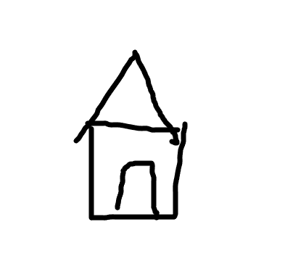
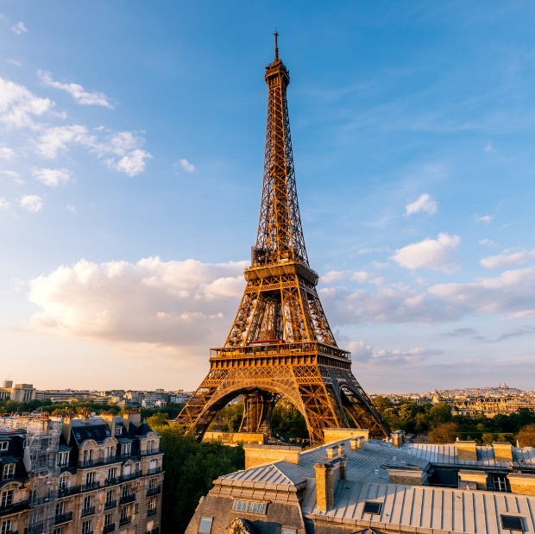
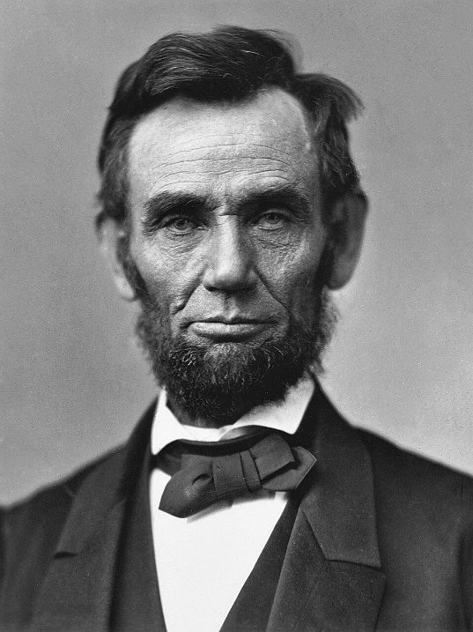
How do we SEE?

Slide 2
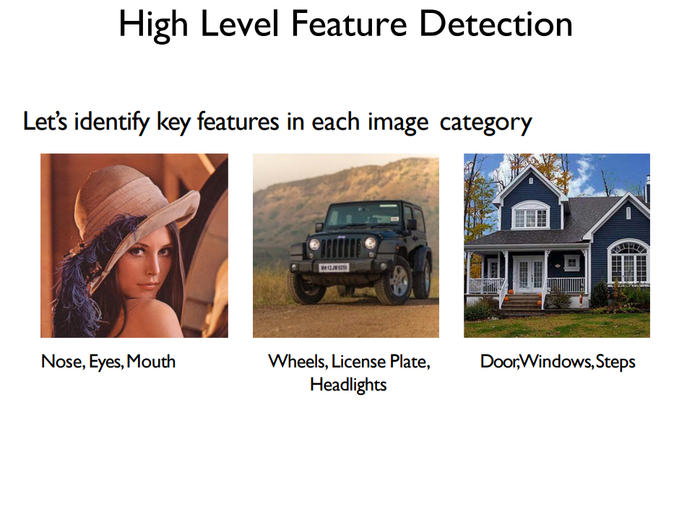
How do we SEE?

Slide 3
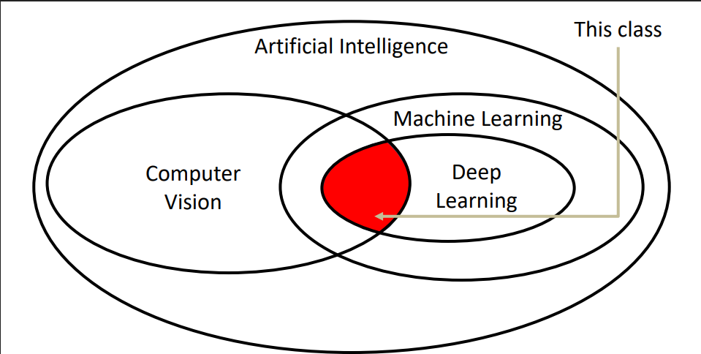
How do computers SEE?

Slide 4
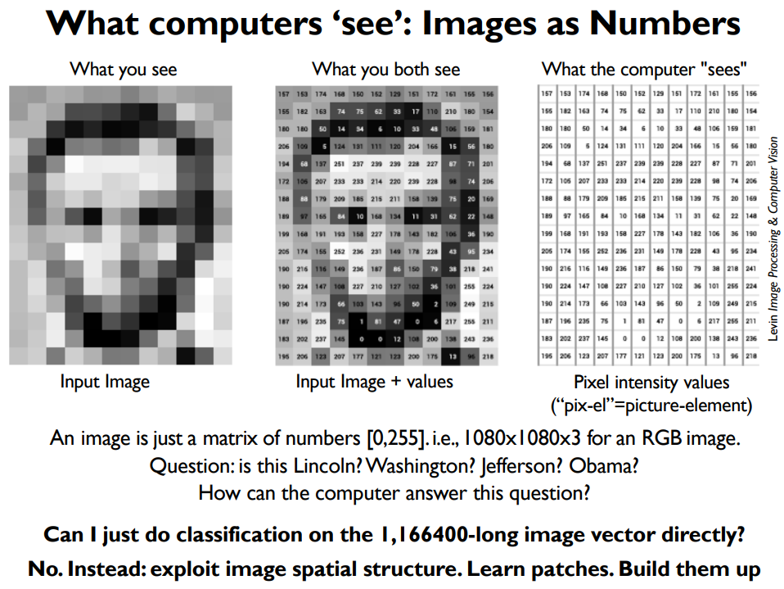

Slide 5
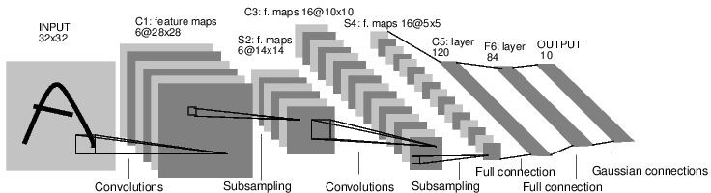
Convolutional Neural Networks
[LeNet-5, LeCun 1980]

Slide 6
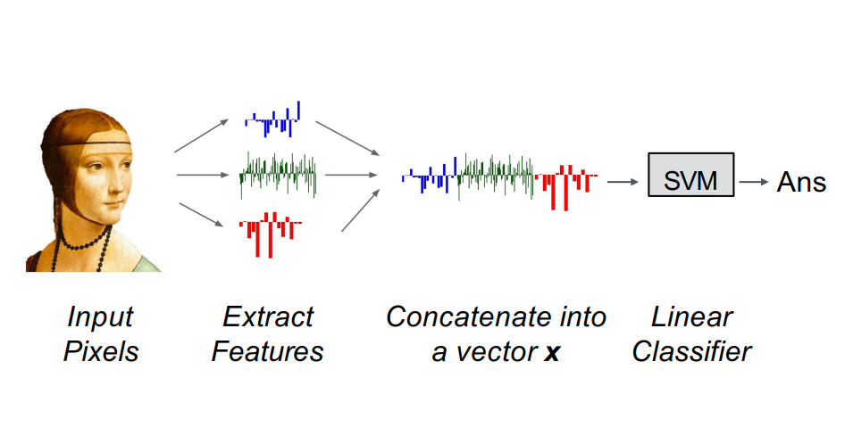
Before CNNs

Slide 7
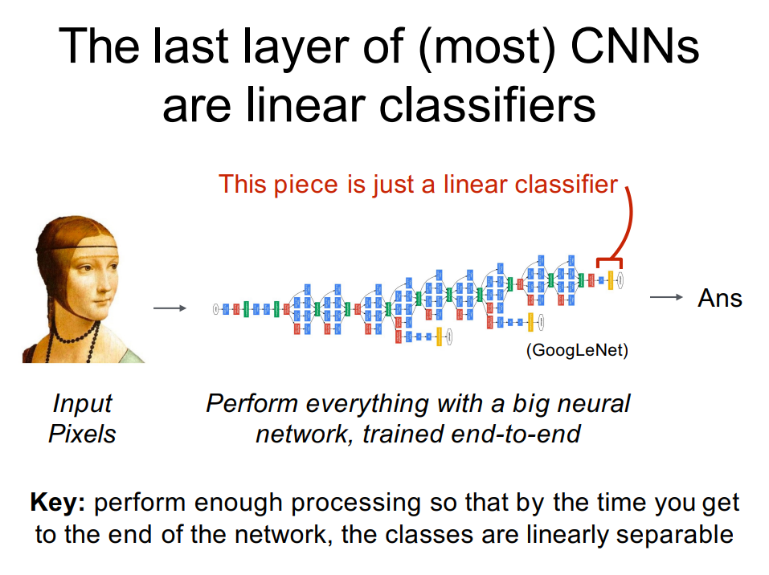

Slide 8
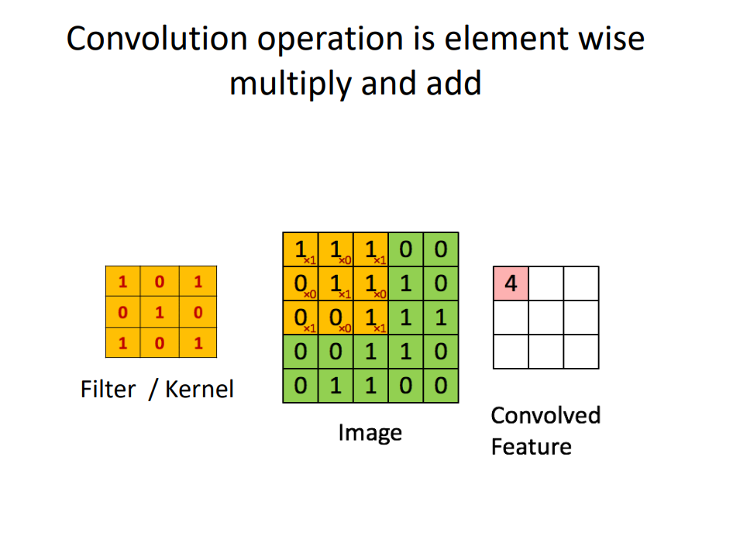
[LeNet-5, LeCun 1980]

Slide 9
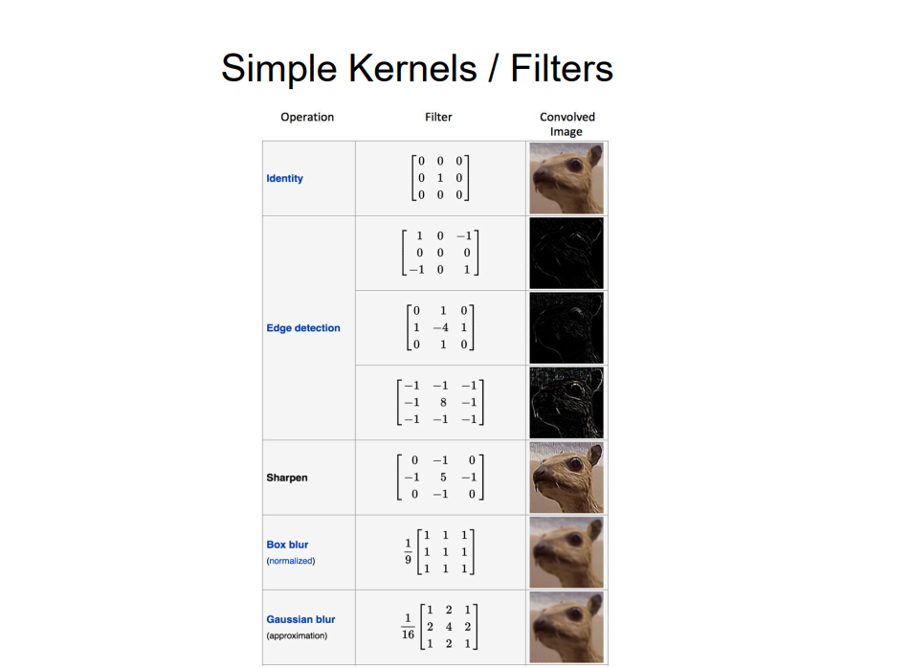

Slide 10
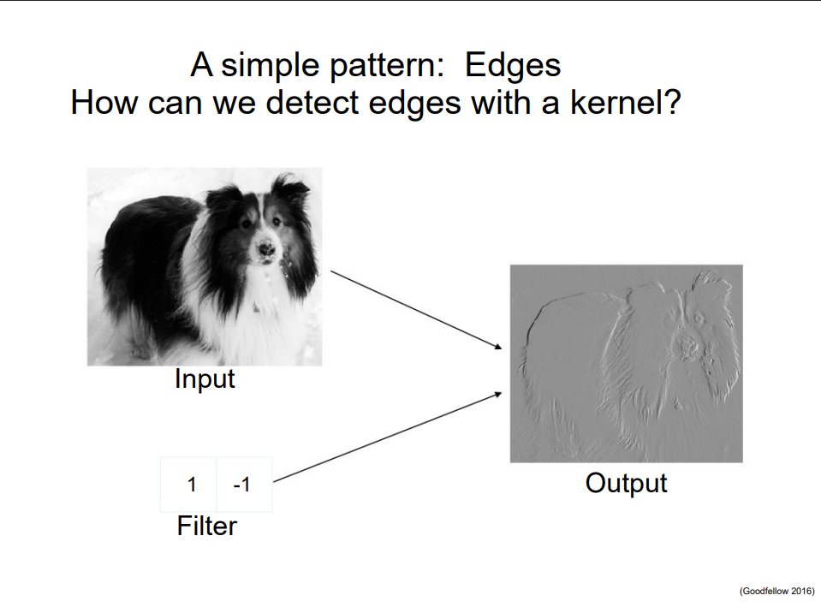

Slide 11
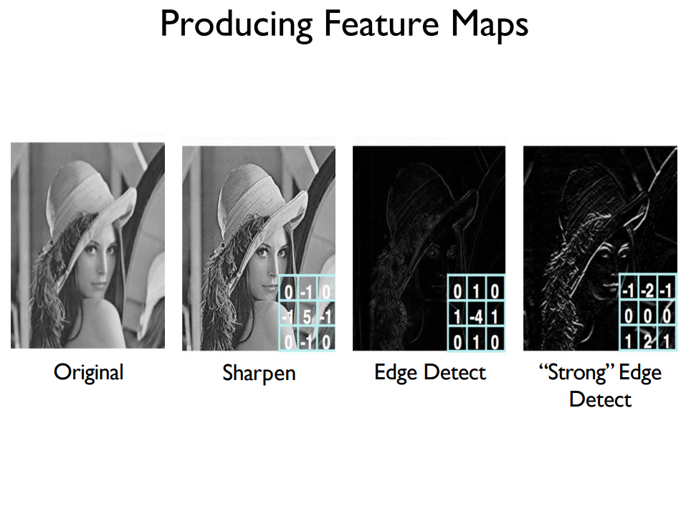

Slide 12
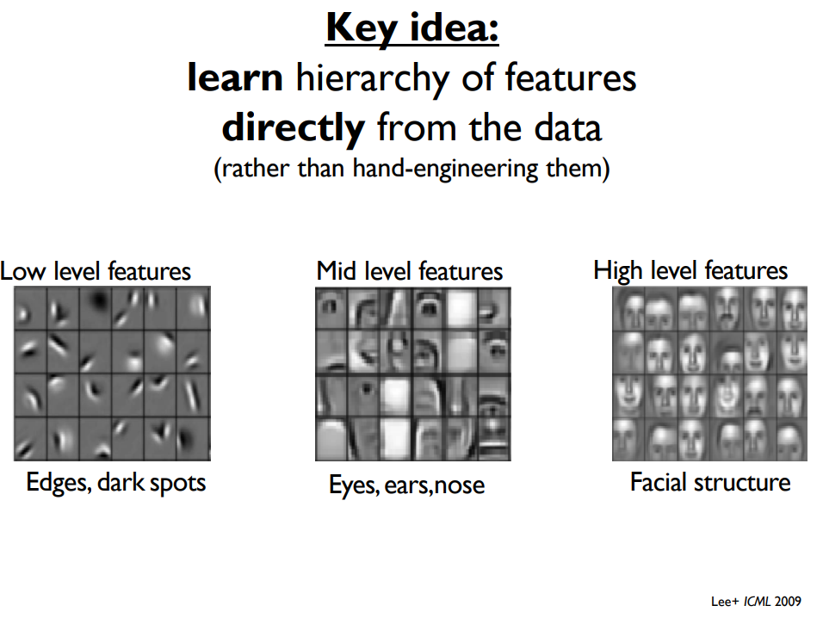

Slide 13
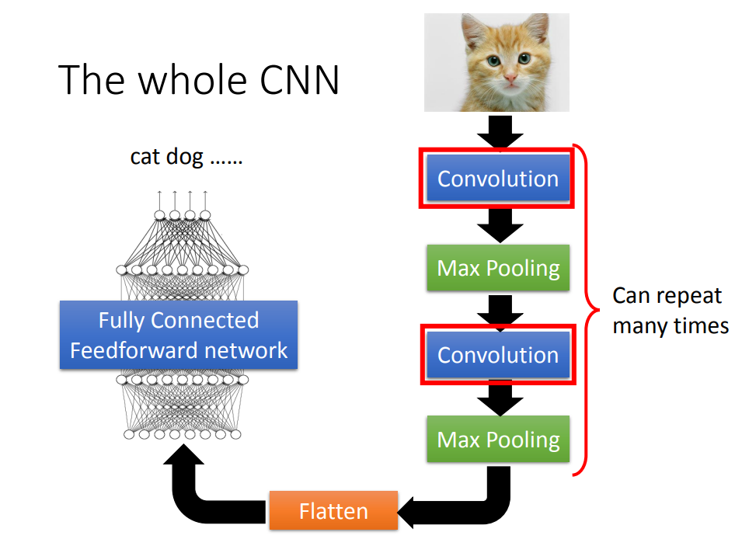

Slide 14
Convolution Layer
32x32x3 image
32
height
32
depth
width
3

Slide 15
Convolution Layer
Filters always extend the full depth of the input volume
32x32x3 image
5x5x3 filter
32
Convolve the filter with the image
i.e. “slide over the image spatially, computing dot products”
32
3

Slide 16
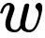
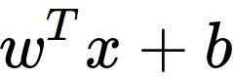
Convolution Layer
32x32x3 image 5x5x3 filter
32
1 number:
the result of taking a dot product between the filter and a small 5x5x3 chunk of the image (i.e. 5*5*3 = 75-dimensional dot product + bias)
32
3

Slide 17
Convolution Layer
activation map
32x32x3 image 5x5x3 filter
32
28
convolve (slide) over all spatial locations
32
28
3
1

Slide 18
consider a second, green filter
Convolution Layer
32x32x3 image 5x5x3 filter
activation maps
32
28
convolve (slide) over all spatial locations
32
28
3
1

Slide 19
For example, if we had 6 5x5 filters, we’ll get 6 separate activation maps:
activation maps
32
28
Convolution Layer
32
28
3
6
We stack these up to get a “new image” of size 28x28x6!

Slide 20
Preview: ConvNet is a sequence of Convolution Layers, interspersed with activation functions
32
28
CONV, ReLU
e.g. 6 5x5x3 filters
32
28
3
6

Slide 21
Preview: ConvNet is a sequence of Convolutional Layers, interspersed with activation functions
32
28
24
….
CONV, ReLU
e.g. 6 5x5x3 filters
CONV, ReLU
e.g. 10 5x5x6 filters
CONV, ReLU
32
28
24
3
6
10

Slide 22
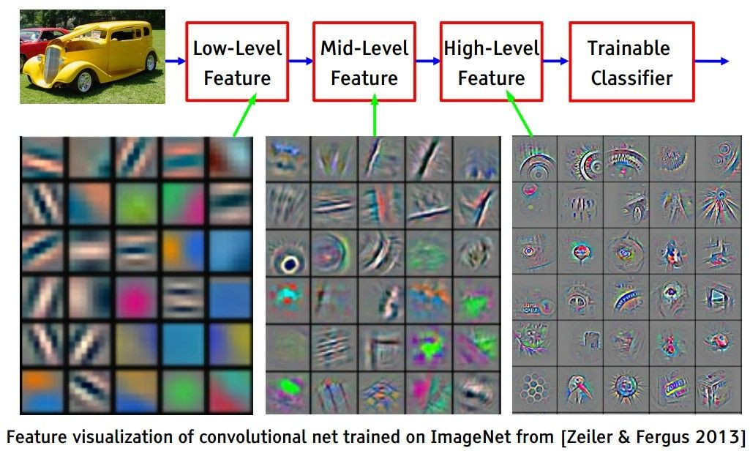
[From recent Yann LeCun slides]
Preview

Slide 23
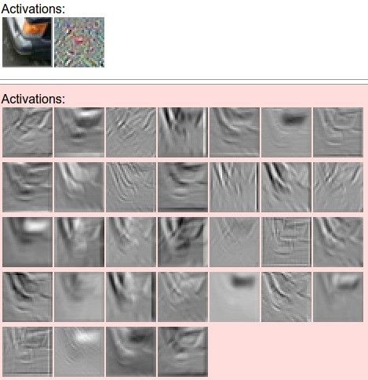



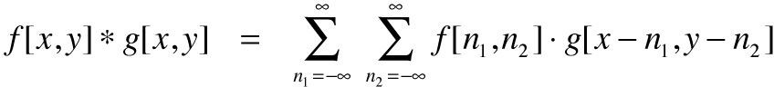

one filter =>
one activation map
example 5x5 filters
(32 total)
We call the layer convolutional because it is related to convolution of two signals:
elementwise multiplication and sum of a filter and the signal (image)

Slide 24
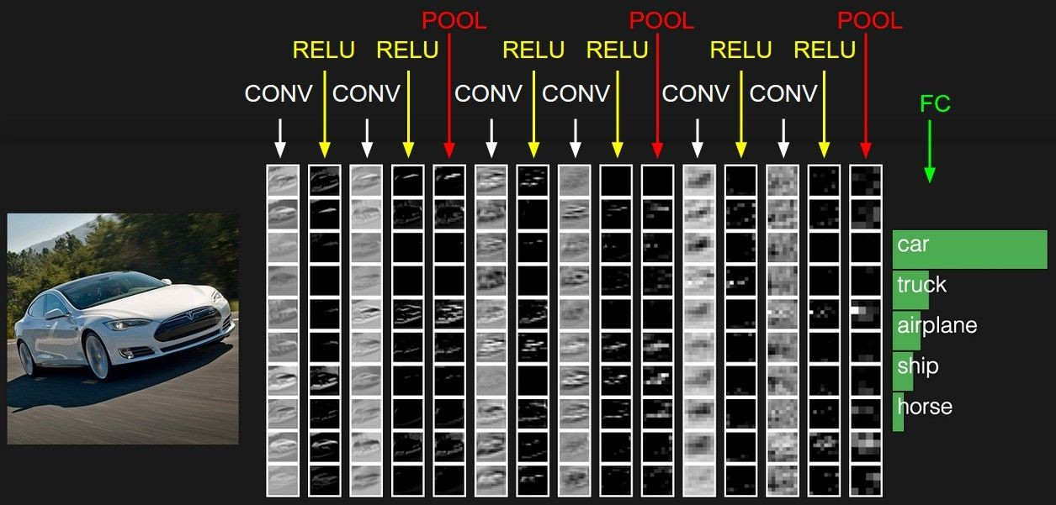
preview:

Slide 25
A closer look at spatial dimensions:
7
7x7 input (spatially) assume 3x3 filter
7

Slide 26
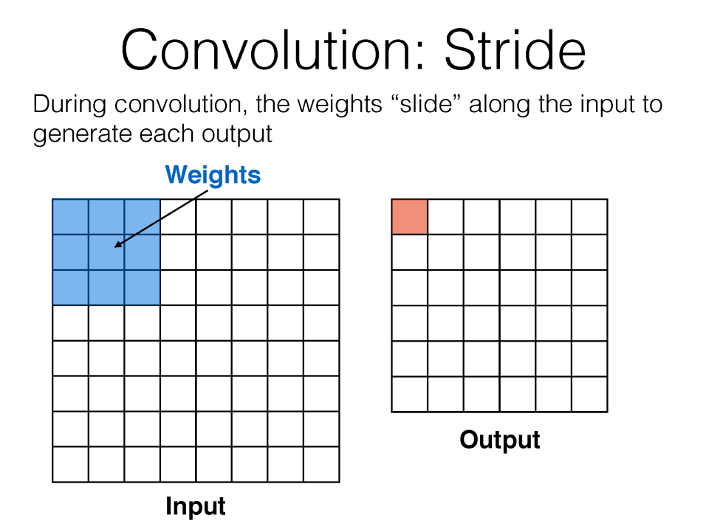

Slide 27
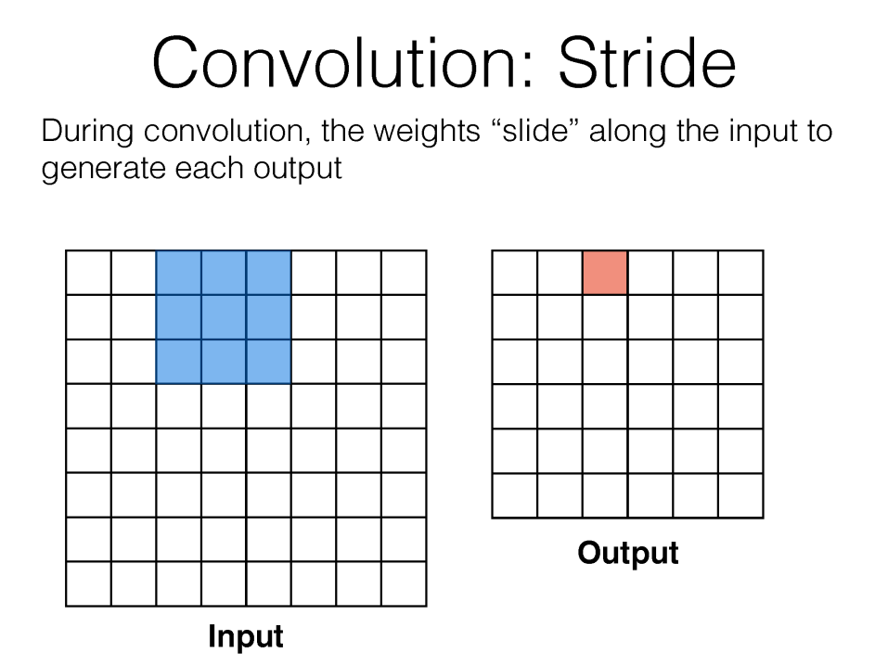

Slide 28
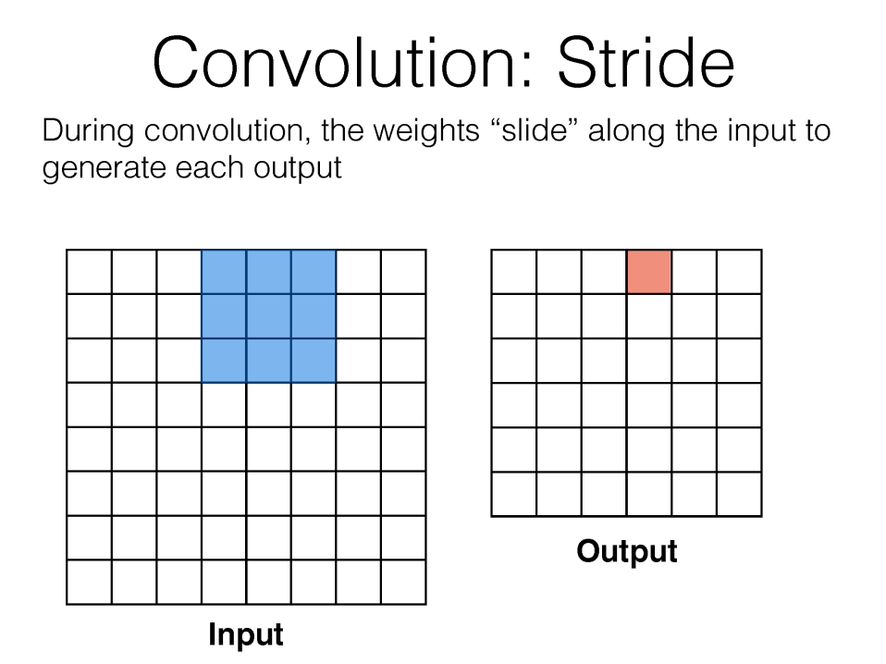

Slide 29
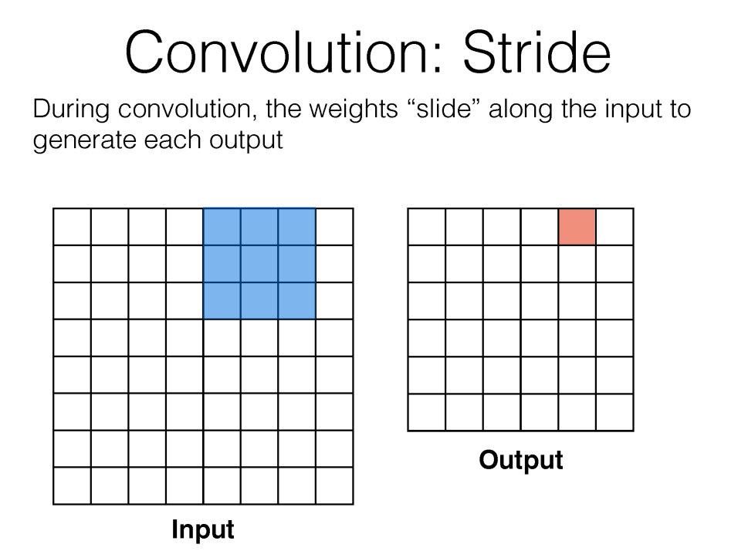

Slide 31
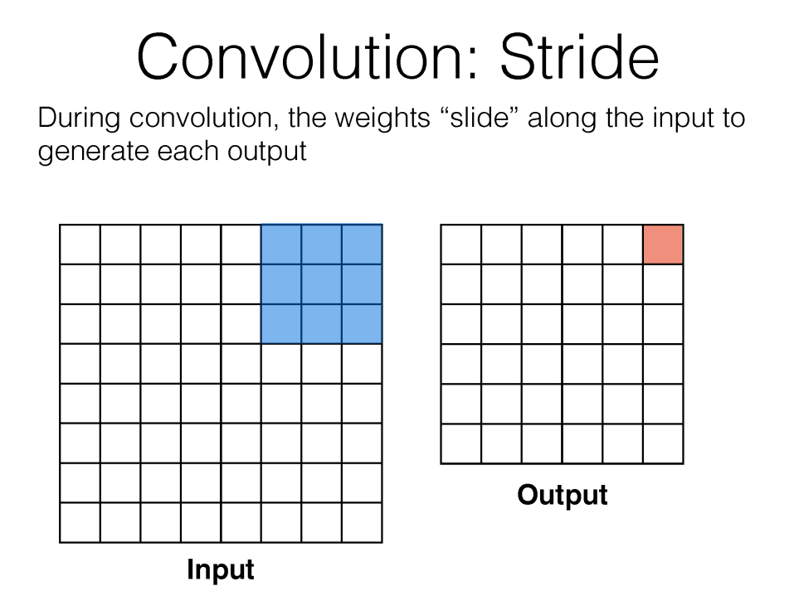

Slide 32
A closer look at spatial dimensions:
7
7x7 input (spatially) assume 3x3 filter applied with stride 2
7

Slide 33
A closer look at spatial dimensions:
7
7x7 input (spatially) assume 3x3 filter applied with stride 2
7

Slide 34
A closer look at spatial dimensions:
7
7x7 input (spatially) assume 3x3 filter applied with stride 2
=> 3x3 output!
7

Slide 35
N
Output size:
(N - F) / stride + 1
 |  |  | F
 | F
e.g. N = 7, F = 3:
stride 1 => (7 - 3)/1 + 1 = 5
stride 2 => (7 - 3)/2 + 1 = 3
stride 3 => (7 - 3)/3 + 1 = 2.33 :\
N

Slide 36
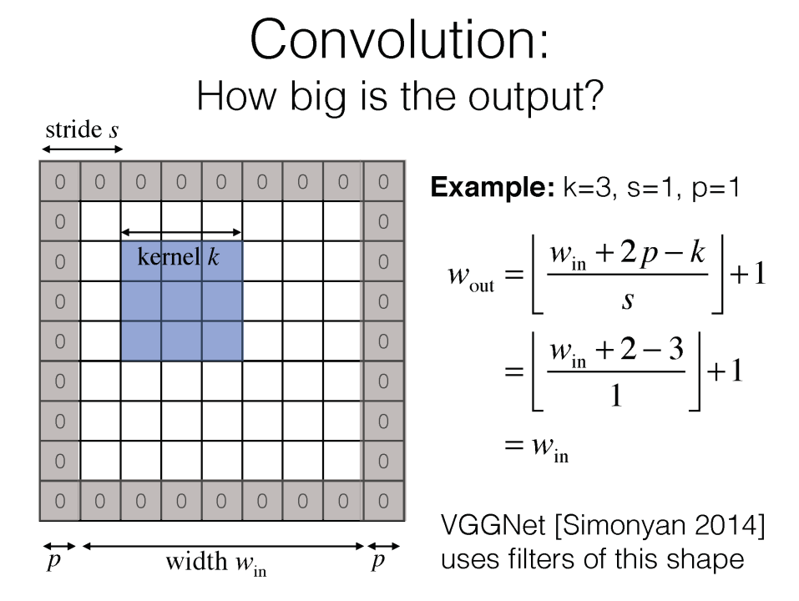

Slide 37
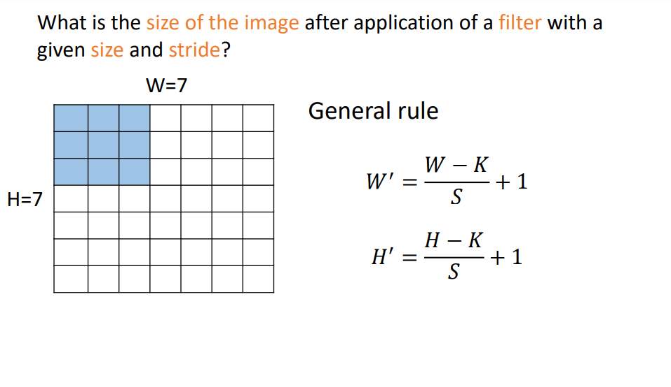

Slide 38
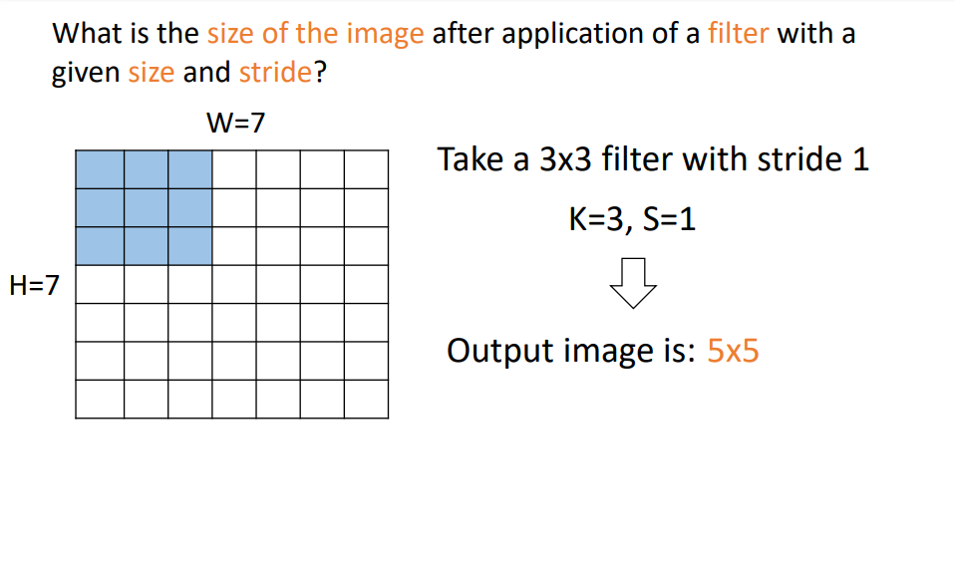

Slide 39
A closer look at spatial dimensions:
7
7x7 input (spatially) assume 3x3 filter applied with stride 3?
7

Slide 40
A closer look at spatial dimensions:
7
7x7 input (spatially) assume 3x3 filter applied with stride 3?
7
doesn’t fit!
cannot apply 3x3 filter on 7x7 input with stride 3.

Slide 41
In practice: Common to zero pad the border
0 | 0 | 0 | 0 | 0 | 0
0
0
0
0
e.g. input 7x7
3x3 filter, applied with stride 1
pad with 1 pixel border => what is the output?
(recall:)
(N - F) / stride + 1

Slide 42
In practice: Common to zero pad the border
0 | 0 | 0 | 0 | 0 | 0
0
0
0
0
e.g. input 7x7
3x3 filter, applied with stride 1
pad with 1 pixel border => what is the output?
7x7 output!
in general, common to see CONV layers with stride 1, filters of size FxF, and zero-padding with (F-1)/2. (will preserve size spatially)
e.g. F = 3 => zero pad with 1 F = 5 => zero pad with 2 F = 7 => zero pad with 3

Slide 43
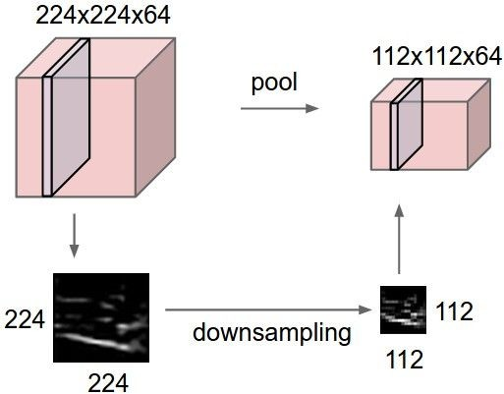
Pooling layer
makes the representations smaller and more manageable
operates over each activation map independently:

Slide 44



MAX POOLING
Single depth slice
1 | 1 | 2 | 4
5 | 6 | 7 | 8
3 | 2 | 1 | 0
1 | 2 | 3 | 4
x
max pool with 2x2 filters and stride 2
6 | 8
3 | 4
y

Slide 45
Fully Connected Layer (FC layer)
- Contains neurons that connect to the entire input volume, as in ordinary Neural Networks

Slide 46
two more layers to go: POOL/FC

Slide 47
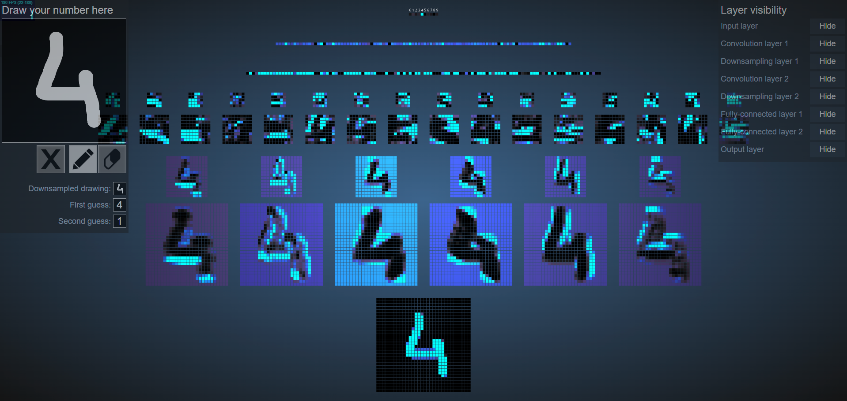
An Interactive Node-Link Visualization of Convolutional Neural Networks
https://adamharley.com/nn_vis/

Slide 48
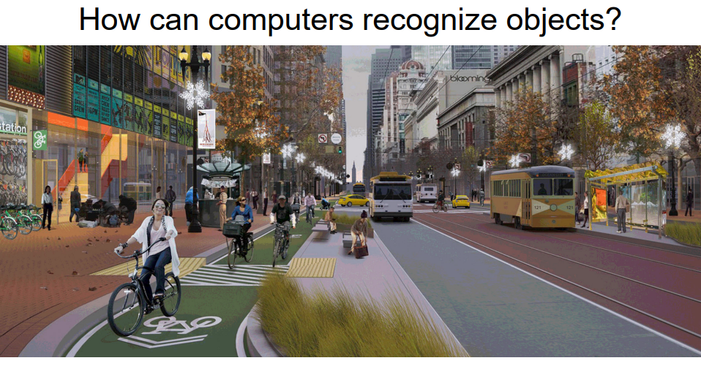
Real-world feature invariance is hard

Slide 49
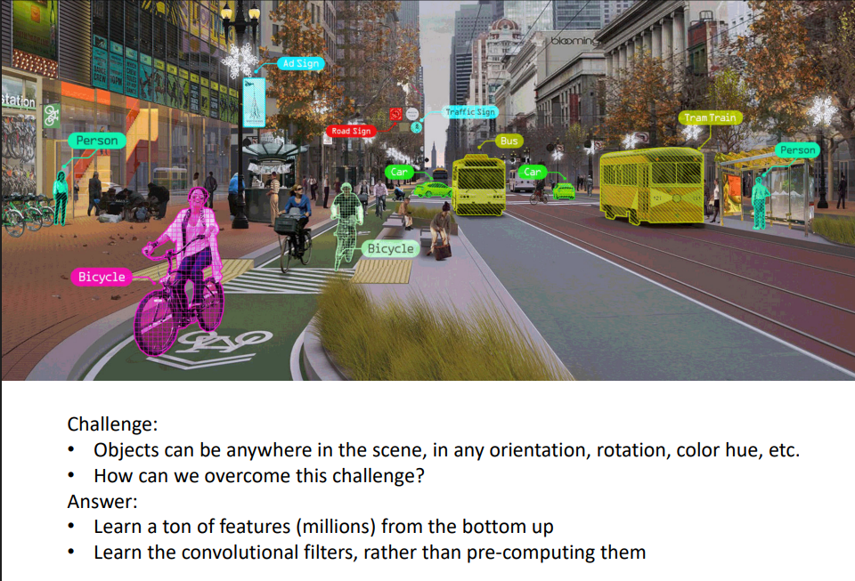
Real-world feature invariance is hard

Slide 50
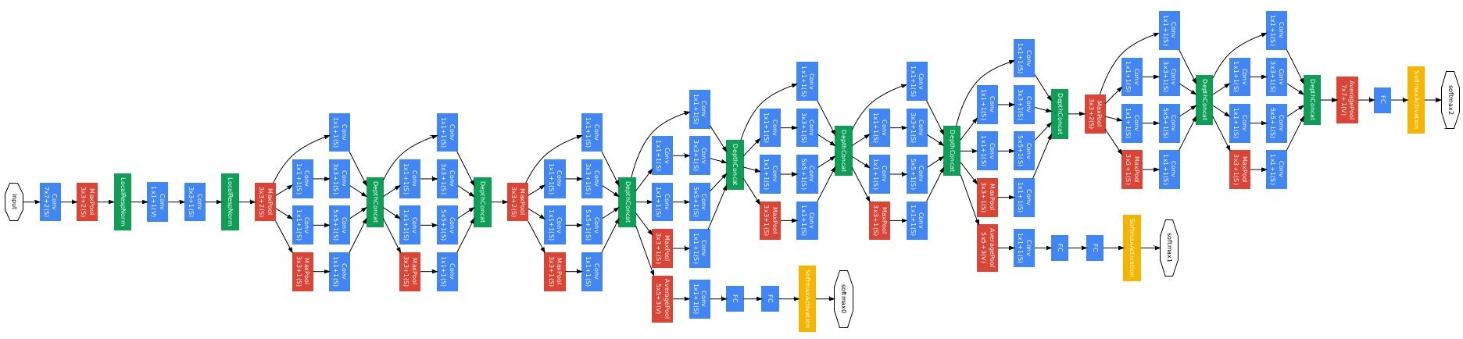
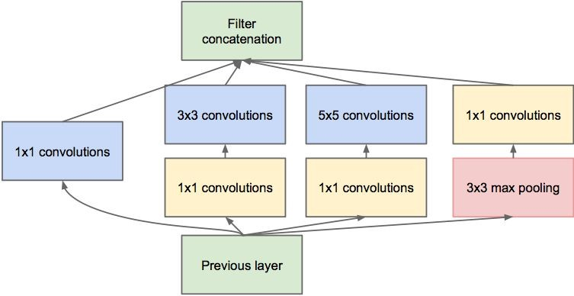
Case Study: GoogLeNet
[Szegedy et al., 2014]

Slide 51
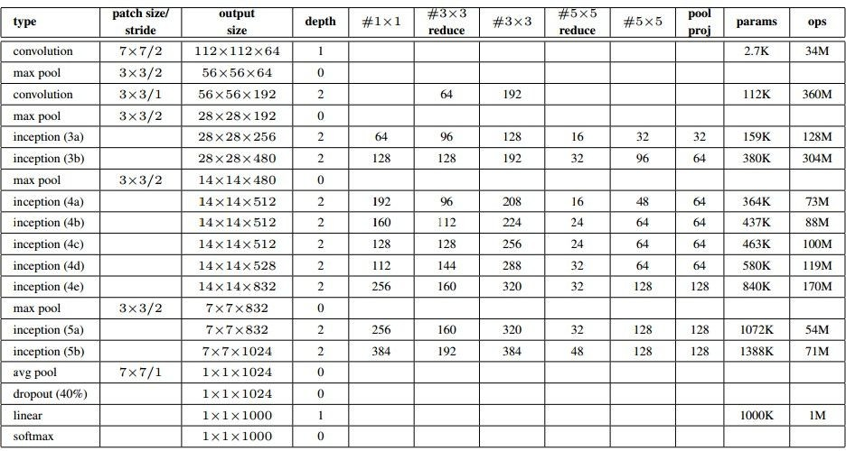
Case Study: GoogLeNet
Fun features:
Only 5 million params! (Removes FC layers completely)
Compared to AlexNet:
12X less params
2x more compute
- 6.67% (vs. 16.4%)

Slide 52
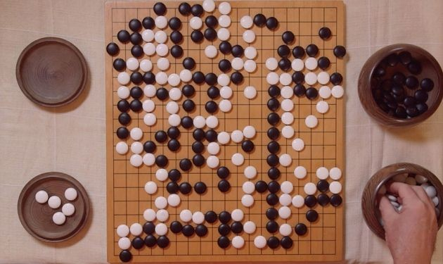
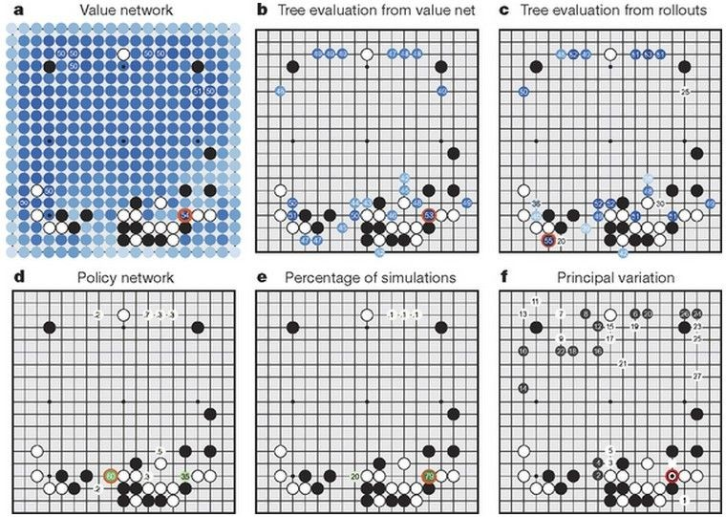

Case Study Bonus: DeepMind’s AlphaGo

